Slide 1
Relationships, Sex and Health Education (RSHE)
Tuesday 2nd June 2026
Parent Meeting
Chloe Timanti & Tori Tapp

Slide 2

Understanding RSHE in schools
We want all children to grow up healthy, happy, safe, and able to manage the challenges and opportunities of modern Britain
These lessons are designed to equip your child with knowledge to make informed decisions about their wellbeing, health and relationships as well as preparing them for a successful adult life.
Notes:
Since September 2020, all primary age children have been taught Relationships and Health Education.
The world for all young people looks very different from the way it did 20-30 years ago when this curriculum was last updated – these changes bring the content into the 21st century, so that it is relevant for your child.

Slide 3
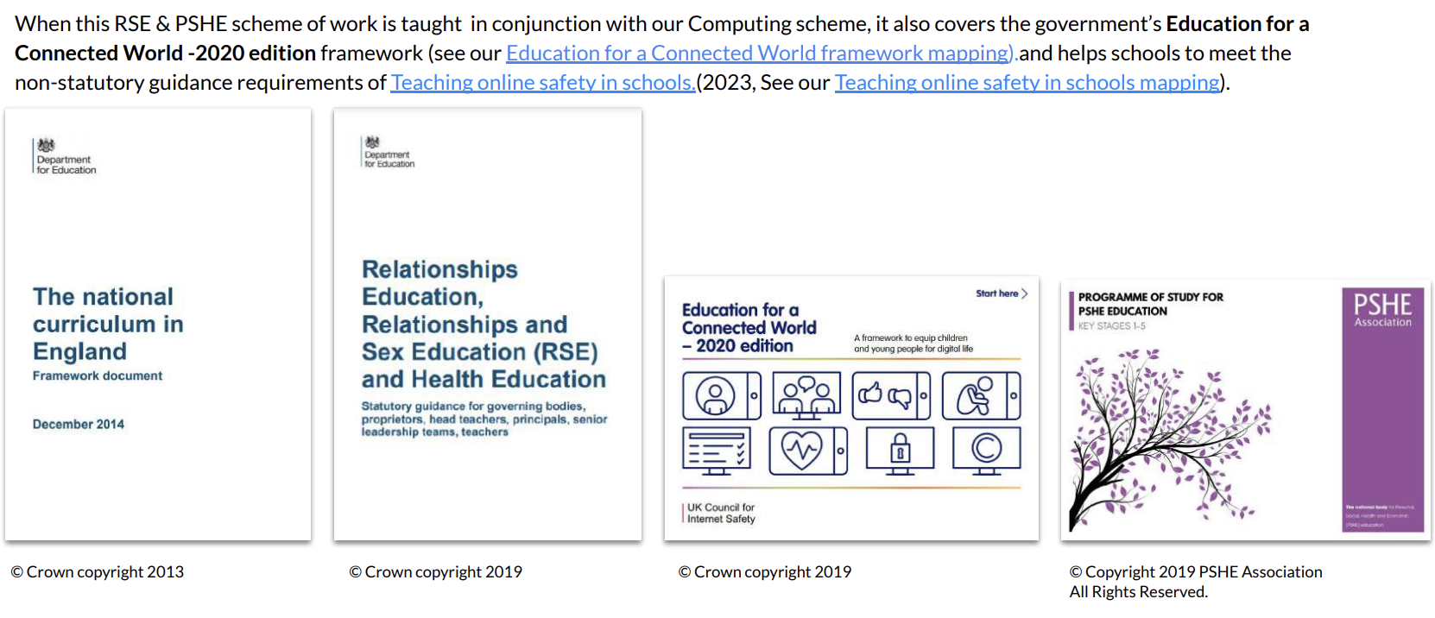
Relationships, Sex and Health Education –Guidance
Notes:
Please refer to school policy and guidance.

Slide 4
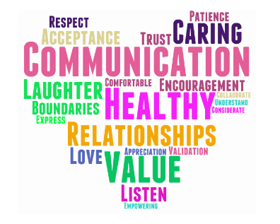
Relationships, Sex and Health Education – What is it?
The PSHE curriculum is broken down into:
Relationship Education
Health Education
From September 2020 and the 2014
supplementary guidance,
the Relationships and Health aspects
of PSHE education is compulsory in all schools.

Slide 5
Relationships, Sex and Health Education– What is it?
By the end of primary school, pupils will have been taught content on:
Relationships Education
families and people who care for me
caring friendships
respectful relationships
online relationships
being safe
Health Education
• mental wellbeing
• internet safety and harms
• physical health and fitness
• healthy eating
• facts and risks associated with drugs, alcohol and tobacco
• basic first aid
• changing adolescent body
Notes:
Relationships Education, Relationships and Sex Education (RSE) and Health Education Guidance (DfE 2019) states that these subjects ‘…put in place the key building blocks of healthy, respectful relationships, focusing on family and friendships, in all contexts, including online.
This will sit alongside the essential understanding of how to be healthy.’

Slide 6
Relationship Education
Relationships Education includes family relationships, friendships and relationships with peers and adults, healthy and unhealthy relationships, the characteristics of positive relationships, relationships online and the emotional, social and physical aspects of growing up.
Relationship and Sex Education is not about the promotion of sexual orientation or sexual activity – this would be inappropriate teaching. (SRE Guidance DfE 2000)
Notes:
We are not promoting anything we are teaching correct terminology in a safe environment. Not sharing personal information.

Slide 7

Aims
We aim to provide an inclusive approach for all children.
Every pupil will receive their full entitlement to RSHE regardless of their educational ability, gender, race, disability, sexual orientation, ethnicity or faith.
We aim to support pupils in their emotional, cultural and social, as well as academic development.
Resources are carefully selected to support all learners.

Slide 8
What is sex and relationships education?
We believe that appropriate education about relationships and sex will:
Help our pupils gain self-confidence, develop self-esteem and self-discipline
Provide pupils with knowledge and understanding of a variety of relationships
Help our pupils develop positive relationships with one another and with adults
Develop the pupil’s ability to identify any concerns they have about a relationship
Encourage respect for one another's individual thinking and attitudes
Encourage good manners and politeness.
Give pupils an awareness of the process of growing up and the changes
The aim of RSHE is NOT to:
encourage pupils to become sexually active at a young age
promote a particular sexual orientation
sexualise children and young people

Slide 9
What programme do we use?
At Carterhatch we use a scheme of work called KAPOW.
We have the most up to date edition and have reviewed the content to ensure it meets the needs of our pupils in an age appropriate manner.
During these sessions, pupils are sat in a circle with a focus on setting ground rules in a safe and inclusive environment.

Slide 10
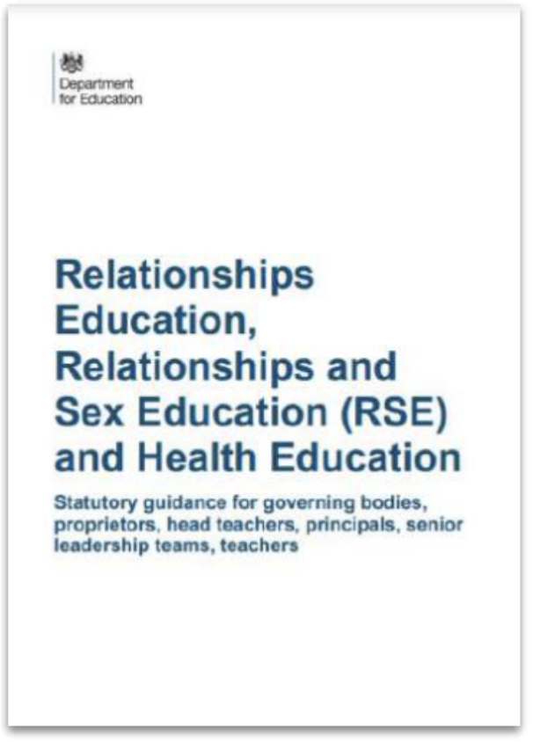

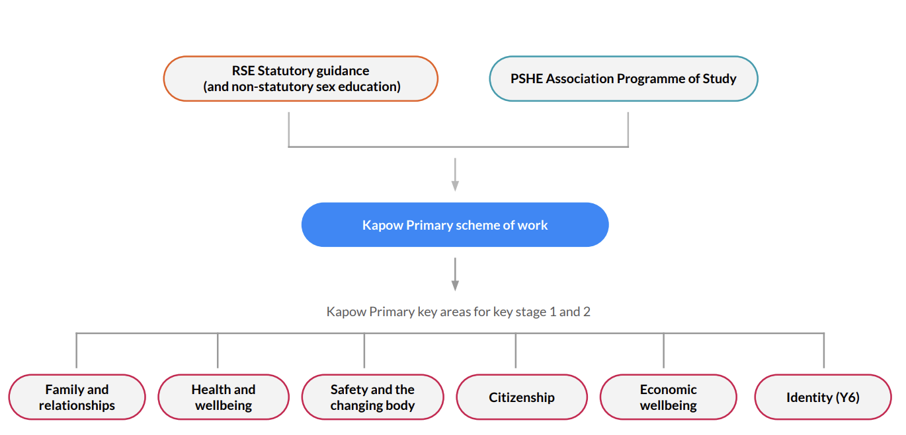
KAPOW overview

Slide 11
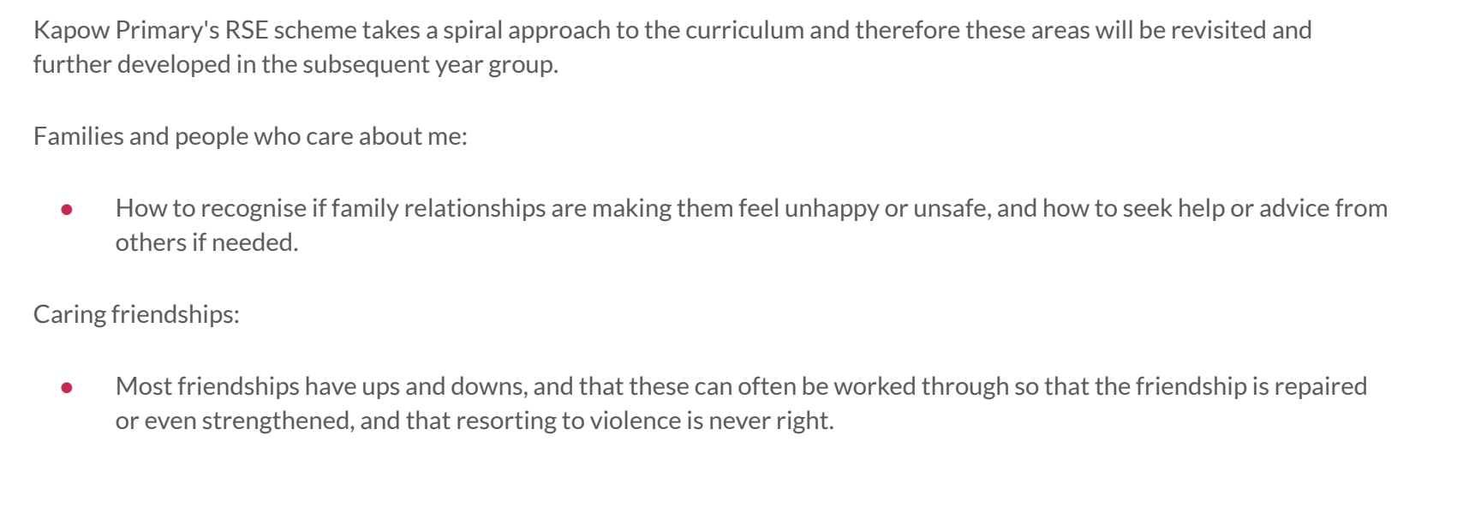
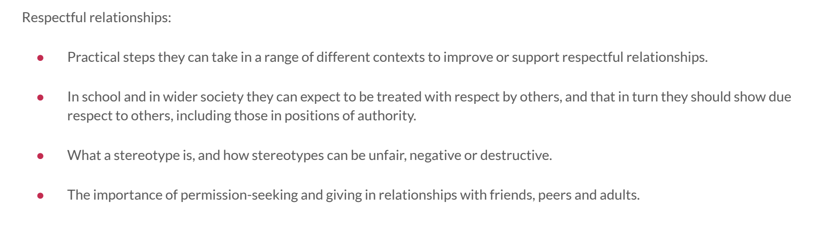
KAPOW Year 6 overview

Slide 12
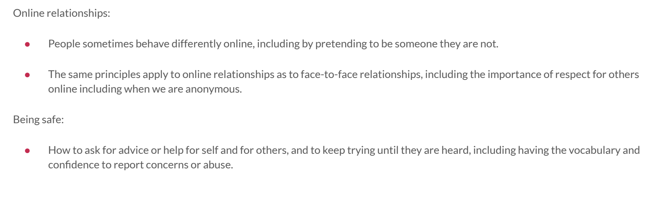
Year 6 - Online overview

Slide 13
“Q: What about RSE for pupils with SEND in mainstream education?
Pupils with SEND in mainstream schools may need additional support to make sense of RSE lessons, sometimes separate small group sessions or individual work can help, especially since aspects of their maturity may lag behind their peers.
It may be appropriate to offer additional small group sessions for pupils with SEND which allow for questions and discussion that might be challenging or increase the risk of bullying in a usual class format.”

Slide 14
Children’s questions
Pupils are given the opportunity to ask questions within each session and have the chance to ask anonymous questions at the end of each session.
Teachers will answer questions which link to the age-related content for their year group. Meaning if they asked a question about content they will learn in Year 6 it will not be answered in Yr 5.
Notes:
Tori
Pupils are encouraged not to use ‘slang’ or ‘family’ names and terms. The teacher will always use the correct biological terminology. Questions will only be answered in the context of the lesson objective.
If a question is deemed inappropriate if it is not connected to the subject matter or it goes beyond the age or stage the teacher will explain that only questions that are relevant will be answered and that if their question has not been answered that he child asks his/her parents.

Slide 15
Right to withdraw
Relationships Education is compulsory meaning you do not have the right to withdraw your child from these lessons however you can withsdraw from the Sex Education lessons (Lessons 3 -4).
Your child can be withdrawn from these lessons except from Science lessons which teach about human development including reproduction.
Please put this in writing to Helen by emailing enquiries or writing a letter by
Tuesday 9th June 2026.

Slide 16
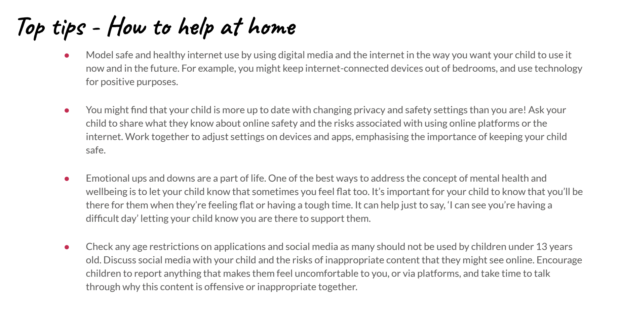

Slide 17


