Slide 1
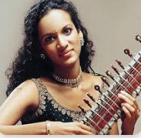
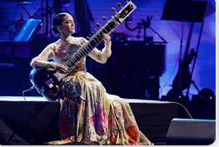
Anoushka Shankar
Autumn Term 2025
1981 - Current

Slide 2
Composer Recap
Retrieval: knowing more, remembering more

Slide 3


Question:
Name the composer, piece and setting!
Clue:
Sporting event

Slide 4
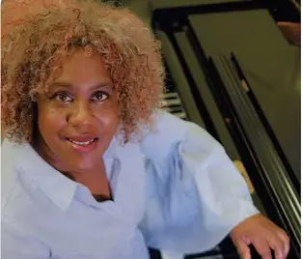
Answer:
Composer: Errollyn Wallen
Piece: Spirit in Motion
(Paralympics)

Slide 5
Question:
Name the composer/piece.

Slide 6
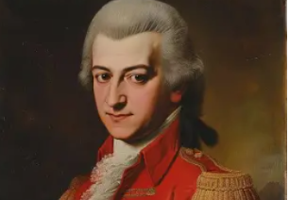
Answer:
Composer: Mozart
Piece: Eine kleine nachtmusik

Slide 7
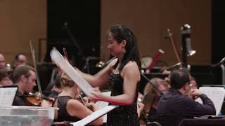
Question:
Name the composer/piece.

Slide 8
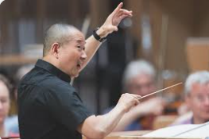
Answer:
Composer: Tan Dun
Piece: Water Concerto

Slide 9
Anoushka Shankar
Autumn Term 2025
1981 - Current

Slide 10
Autumn Term Composer - Anoushka Shankar (World Music - Indian Classical Fusion)
Age/Era: A world-renowned sitar player and composer, born in 1981, who blends traditional Indian classical music with various global genres like flamenco and jazz.
Listening Example https://www.youtube.com/watch?v=3Kcdme8DLTs
Date of Birth: 9th June 1981 / Birth Location: London, England
Nationality: British / Indian
3 Famous Pieces:
  "Traces of You" – a beautiful piece featuring her half-sister Norah Jones.
  "Traveller" – an album and piece that explores the connections between Indian and Spanish music.
Where they studied: Primarily trained by her legendary father, Ravi Shankar, a master of the sitar.

Slide 11
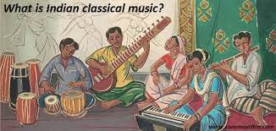
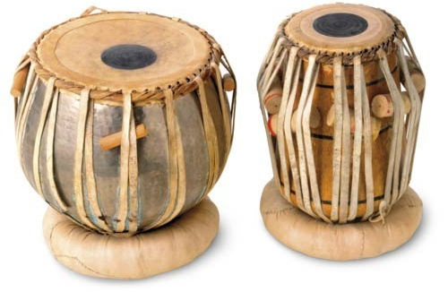
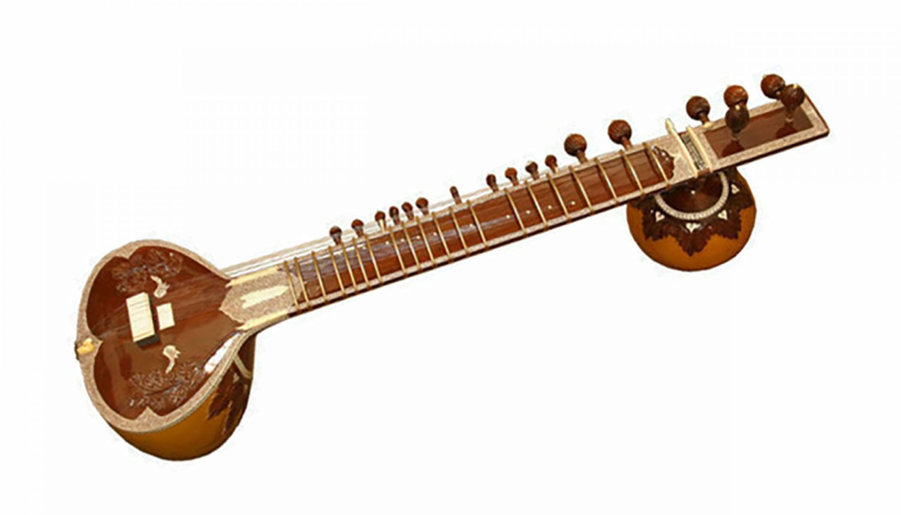

Vocabulary
Vocabulary | Definition | Image
Indian Classical Music | Indian Classical Music is an ancient form of traditional music (over 6000 years old). The music is typically passed down orally and is very connected to nature.
Tabla Drums | A tabla is a pair of twin hand drums from from India. Tabla is an important instrument in Indian Classical Music. Tabla can be played as a solo or used to accompany a singer/ensemble.
Sitar | The sitar is a longed necked string instrument. It’s the equivalent to an indian classical guitar.
Call and Response | Call and response is a question and answer phrase in music.

Slide 12
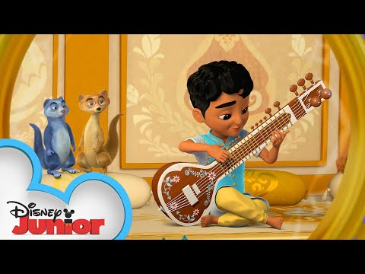
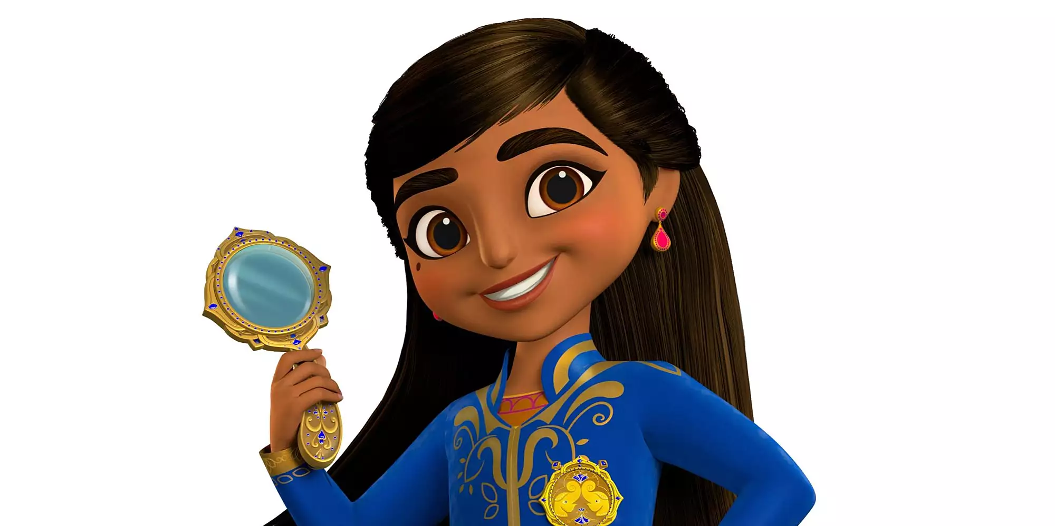
Here is a quick introduction to the Sitar and Tabla from someone else who will be helping us this term – Mira, Royal Detective.

Slide 13
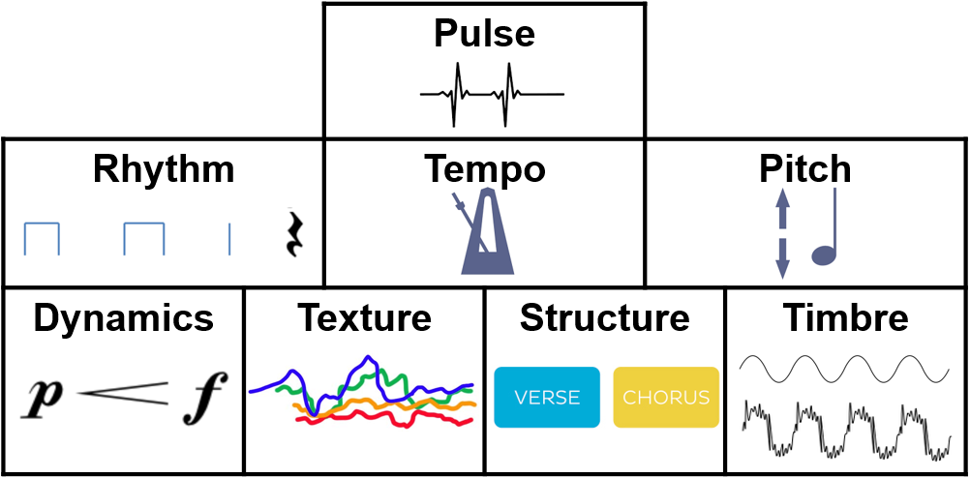
Before listening, lets recap the Elements of Music
Chant:
Pitch is high and low
Tempo is fast and slow
Rhythm is a pattern of long and short sounds
Dynamics are Loud or Soft
Texture is Thick or Thin
(how many layers/instruments are present)
Extra elements to discuss:
Structure - The order of the music (verse/chorus)
Timbre - The tone or quality of the sound. Adjectives that describe the sound (harsh/smooth/sharp/bright etc).
What elements of music can you hear in the piece?

Slide 14
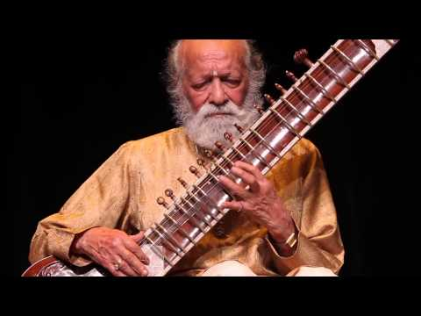
Let's explore what Indian Classical Music sounds like in real life! This is Ravi Shankar (Anoushka’s Farther)
Notes:
https://www.youtube.com/watch?v=zVqvd6mhat8
Open up discussion with the class about what they thought/how they felt listening to this piece of music. Have they heard anything like this before? Where? What sounds did they like the best? Why? Etc.

Slide 15
The music you heard in this clip used two very important instruments which we will learn about this term.
The Tabla –
a pair of small
hand drums.
The Sitar –
a large, long-necked Indian guitar.

Slide 16
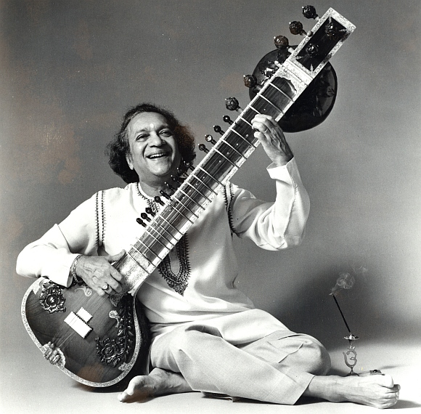
The soloist in the video who was playing the sitar was a very famous Indian musician called Ravi Shankar.
The Sitar –
a large, long-necked Indian guitar.

Slide 17
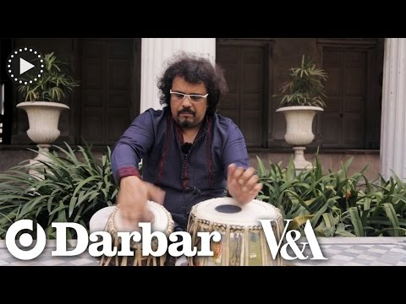

So we have two instruments to learn about – the Tabla and the Sitar. Let's focus first on The Tabla for this lesson!
What is interesting about Tabla is that you learn to speak/say the sounds the drums can make before you learn to play them. Like this...
Tabla Improvisation
Tabla Phonetics

Slide 18
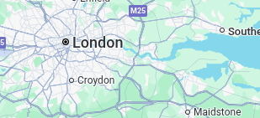

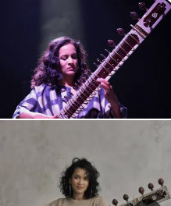
Autumn Term:
Anoushka Shankar
Date of Birth: 9th June 1981
Birth Location: London, England
Nationality: British / Indian
.
Iconic moments:
Performance at BBC Proms on 12th August 2025 Ft London Contemporary Orchestra
First Indian musician to perform live at the Grammy Awards on 13th February 2005, following her nomination for the album Rise.
Early life: Born in London in 1981, Anoushka grew up moving between London, Delhi and California. Her father was the legendary sitar player, Ravi Shankar! You might have heard of him because he taught The Beatles' George Harrison to play the sitar. He was also our composer in 2021/22.
Famous Pieces:
Traces of You
This piece is a memorial to her father and blend Indian classical music with various other genres.
Boat to Nowhere is the first song on her 2016 album, Land of Gold, and it serves as a powerful opening to the album's central theme of the global refugee crisis.
Voice of the Moon is a significant piece featured on her 2005 album, Rise. It is a beautiful example of her unique ability to blend traditional Indian classical music with contemporary and Western sounds.
Early Career/Family
Anoushka's music is a cool mix of different styles. She started by playing traditional Indian classical music at the age of 7, just like her father (Ravi Shankar). As she got older, she began to experiment, blending her sitar with modern music like electronic beats, jazz, and even Spanish flamenco. Anoushka also has a famous half-sister, the singer Norah Jones. She has featured in many of her pieces over the years.
Notes:
https://www.youtube.com/watch?v=slp-NY8Fb-I

Slide 19
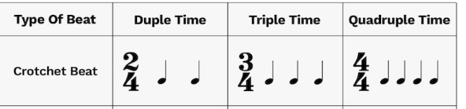


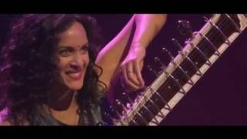
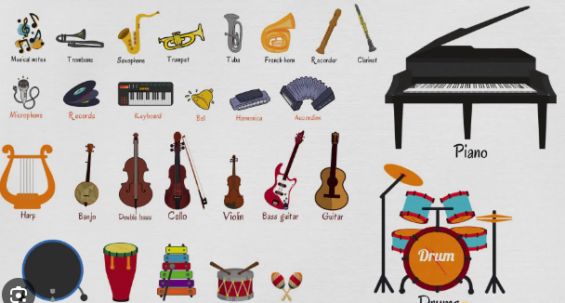
Piece: Voice of the Moon Composer: Anoushka Shankar
Time Signature
Major Minor
How does it make you feel?
What musical elements are being used?
What is the time signature?
Major or Minor key?
Summary: The core of the song is Anoushka Shankar's masterful sitar playing. The piece begins with a slow, sweet and dream-like melody, gradually building in tempo and complexity. The sitar is complemented by a blend of Indian and Western instruments, creating a rich and innovative sound. These instruments include: Sitar, Tabla (percussion), Shehnai (woodwind), Cello (strings), Keyboard and Hang (percussion).
Instruments
Live in France 2014

Slide 20

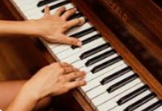
Poster 1:
Anoushka Shankar
Write down 3 facts about Anoushka Shankar!
Use your facts, or discuss with a partner!
Starting points
Where was she born (location)?
What year was she born (date)?
What instruments does she play?
What are some of her achievements?

Slide 21
Test the Knowledge(Anoushka Shankar)
What instrument does Anoushka play?
2. Name one of her biggest achievements?
3. Name one of her famous pieces!
4. Who was her father?

Slide 22
Anoushka Shankar
Session 2: Graphic Scores

Slide 23
Let’s recap the Elements of Music
Chant:
Pitch is high and low
Tempo is fast and slow
Rhythm is a pattern of long and short sounds
Dynamics are Loud or Soft
Texture is Thick or Thin
(how many layers/instruments are present)
Extra elements to discuss:
Structure - The order of the music (verse/chorus)
Timbre - The tone or quality of the sound. Adjectives that describe the sound (harsh/smooth/sharp/bright etc).
What elements of music can you hear in the piece?

Slide 24
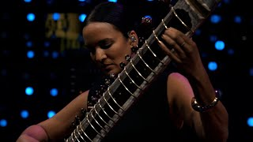
Piece: Boat to Nowhere Composer: Anoushka Shankar
Time Signature
Major Minor
Summary: Boat to Nowhere is a song by Anoushka Shankar from her album Land of Gold. It's not a regular pop song, but a special genre of music that tells a story without any words. It uses the beautiful sounds of the sitar to describe a very sad and dangerous journey.
The album Land of Gold is all about helping us understand what it's like for refugees, who are people who have to leave their homes because of war or other big problems. The music in "Boat to Nowhere" paints a picture of these people getting on a small, shaky boat to go to a new place. It's a journey filled with hope, but also a lot of scary unknowns.
Instruments
Live in 2023

Slide 25
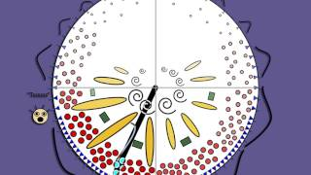
Activity 2: Graphic Score
We’re going to create a graphic score while listening to Boat to Nowhere.
Let’s have a look an example of a graphic score! Does it represent the music?

Slide 26
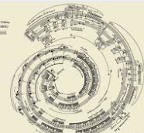
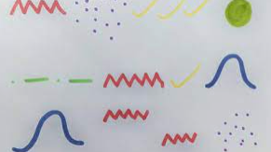
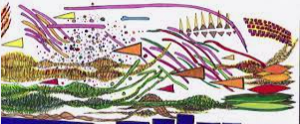
Second Listening: Boat to Nowhere
We’re going to listen to “Boat to Nowhere” while creating a graphic score! A graphic score is a way of using symbols to represent music! Draw whatever you feel while listening to the piece! Use colour pencils to add more texture.
Try and capture the emotional nuances in the music. Identify moments of tension, release and emotions conveyed in your graphic score.
Example 1
Example 3
Example 2

Slide 27
Summary:
What did you enjoy most about this piece?
Can you use any of the elements of music in your answer?

Slide 28
Summary
How did the piece make you feel?
Class discussion!

Slide 29
Session 3
Resources: Music response sheet & pen/pencil

Slide 30
Let’s recap the Elements of Music
Chant:
Pitch is high and low
Tempo is fast and slow
Rhythm is a pattern of long and short sounds
Dynamics are Loud and Soft
Texture is Thick and Thin (how many layers of instruments are present)
Extra elements to discuss:
Structure - The order of the music (verse/chorus)
Timbre - The tone or quality of the sound. Adjectives that describe the sound (harsh/smooth/sharp etc).
What elements of music can you hear in the piece?

Slide 31
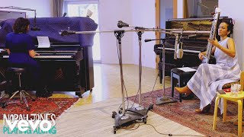
Piece: Traces of You Composer: Anoushka Shankar
Time Signature
Major Minor
Summary: Traces of You is a personal and moving piece of music that serves as a tribute to Anoushka Shankar's late father (the legendary Ravi Shankar). Released in July 2013, the song features her half-sister, singer-songwriter Norah Jones. The track beautifully blends the classical sound of Anoushka's sitar with Norah's gentle, soulful vocals, creating a unique and heartfelt soundscape. The lyrics speak to the idea that people who have passed away leave behind a lasting "trace" on our lives.
Instruments
Live

Slide 32
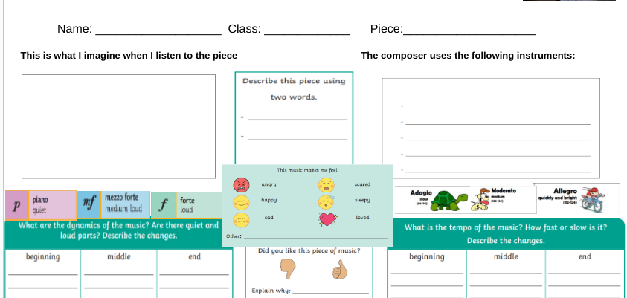
Piece: Traces of You Composer: Anoushka Shankar
Notes:
Students complete the sheet in pairs while listening to the piece

Slide 33
Summary:
What did you enjoy most about this piece?
Can you use any of the elements of music in your answer?

Slide 34
Summary
What do we know and remember?

Slide 35
Test the Knowledge
Who is Anoushka Shankar’s father?
What instrument does she play?
What famous event did she perform at in August 2025?
Where was she born?
Who is her sister?

Slide 36
Anoushka Shankar
Autumn Term 2025
1981 - Current

